Slide 1
EUKARYOTIC CELL (Part-1)
Sonali Saha, Microbioogy

Slide 2
Shape and Size
One hallmark of eukaryotic cells is their morphological diversity. This is especially true for eukaryotic microbes, which are found in numerous habitats and have evolved morphological adaptations accordingly.
In general, eukaryotic cells are larger than bacterial and archaeal cells. This is true for eukaryotic microbes as well. However, just as some bacteria and archaea are very large, even larger than some of the largest protists, so too are there some protists smaller than many bacteria and archaea.
These small eukaryotic microbes include Ostreococcus tauri, the smallest free-living alga known. Many other picoeukaryotes have been discovered in marine environments, as many as 103 to 104 per milliliter.

Slide 3
Cell Organization
Eukaryotic cells are distinctive because of their use of membranes. They have membrane-delimited nuclei, and membranes play a prominent part in the structure of many other organelles.
Organelles are intracellular structures that perform specific functions in cells analogous to the functions of organs in the body of a multicellular organism.
The partitioning of the eukaryotic cell interior by membranes makes possible the placement of different cellular functions in separate compartments so that they can more easily take place simultaneously under independent control and proper coordination. Large membrane surfaces make possible greater respiratory and photosynthetic activity because these processes are located exclusively in membranes. The intracytoplasmic membrane complex also serves as a transport system to move materials between different cell locations. Thus abundant membrane systems probably are necessary in eukaryotic cells because of their large volume and the need for adequate regulation, metabolic activity, and transport.

Slide 4
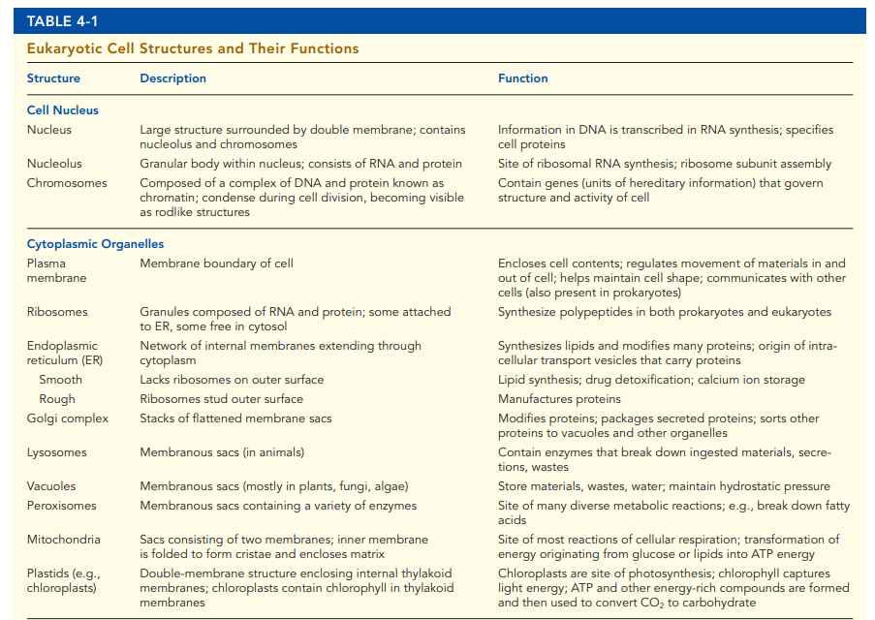
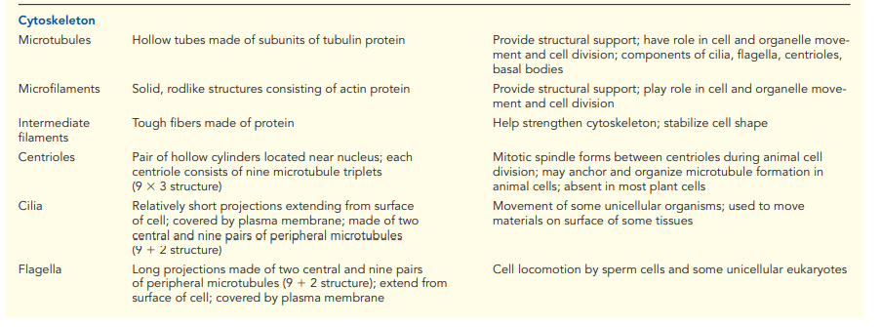

Slide 5
Nucleus
nucleus is the most prominent organelle in the cell. It is usually spherical or oval in shape and averages 5 µm in diameter.
often occupies a relatively fixed position near the center of the cell.
nucleus served as the control center of the cell.
The nuclear envelope consists of two concentric membranes that separate the nuclear contents from the surrounding cytoplasm These membranes are separated by about 20 to 40 nm, a perinuclear space. The nuclear envelope is continuous with the ER at several points, and its outer membrane is covered with ribosomes.
At intervals the membranes come together to form nuclear pores, which consist of protein complexes. Nuclear pores regulate the passage of materials between nucleoplasm and cytoplasm. Many nuclear pores penetrate the envelope, and each pore is formed by about 30 proteins; each pore plus the associated proteins is called a nuclear pore complex. Pores are about 70 nm in diameter and collectively occupy about 10 to 25% of the nuclear surface. Small molecules move through the nuclear pore complex unaided. However, large molecules are transported through the nuclear pore complex. Some nuclear pore complex proteins are involved in these transport processes.
A fibrous network of protein filaments, called the nuclear lamina, forms an inner lining for the nuclear envelope. The nuclear lamina supports the inner nuclear membrane and may have other important functions, such as organizing the nuclear contents. Mutations in proteins associated with the nuclear lamina and inner nuclear membrane are associated with several human genetic diseases, including muscular dystrophies, as well as premature aging.

Slide 6
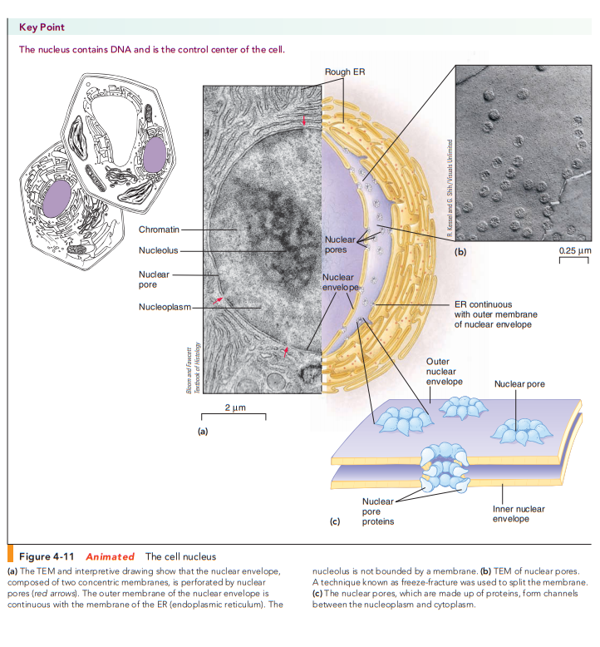
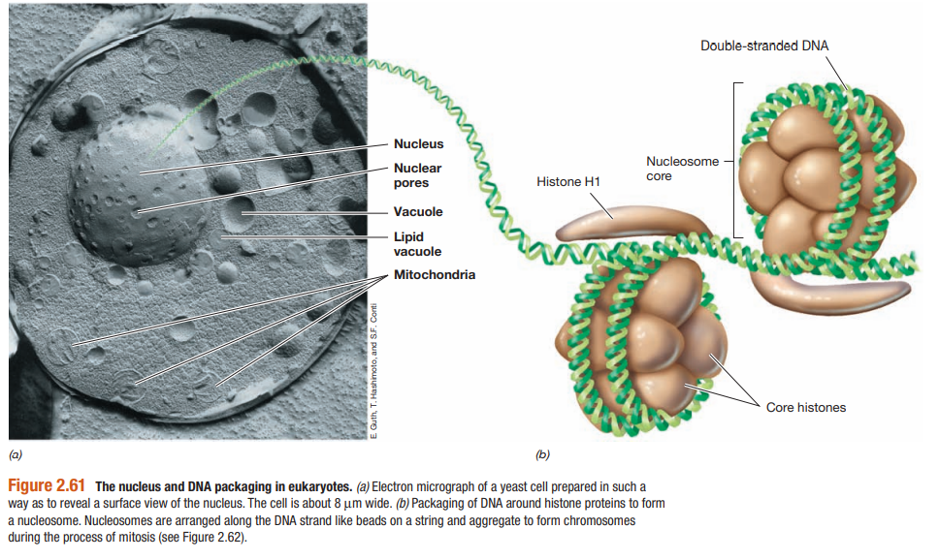

Slide 7
The cell stores information in the form of DNA, located inside the nucleus. When a cell divides, the information stored in DNA must be reproduced and passed intact to the two daughter cells. DNA has the unique ability to make an exact duplicate of itself through a process called replication.
DNA molecules consist of sequences of nucleotides called genes, which contain the chemically coded instructions for producing the proteins needed by the cell. The nucleus controls protein synthesis (Translation) by transcribing its information in messenger RNA (mRNA) molecules. Messenger RNA moves into the cytoplasm, where proteins are manufactured.
DNA is associated with proteins, forming a complex known as chromatin, which appears as a network of granules and strands in cells that are not dividing. DNA molecules are extremely long and thin, they must be packed inside the nucleus in a very regular fashion as part of structures called chromosomes. In dividing cells, the chromosomes become visible as distinct threadlike structures. If the DNA in the 46 chromosomes of one human cell could be stretched end to end, it would extend for 2 m!

Slide 8
DNA within the nucleus is wound around basic (positively charged) proteins called histones, which tightly pack the negatively charged DNA to form nucleosomes and from them, chromosomes.
Most nuclei have one or more compact structures called nucleoli (sing., nucleolus). A nucleolus, which is not enclosed by a membrane, usually stains differently than the surrounding chromatin. Each nucleolus contains a nucleolar organizer, made up of chromosomal regions containing instructions for making the type of RNA in ribosomes.
This ribosomal RNA (rRNA) is synthesized in the nucleolus. The proteins needed to make ribosomes are synthesized in the cytoplasm and imported into the nucleolus and combine with rRNA to form the small and large subunits of eukaryotic ribosomes. Ribosomal RNA and proteins are then assembled into ribosomal subunits that leave the nucleus through the nuclear pores.
Histones are small basic proteins rich in the amino acids lysine, arginine, or both. There are five types of histones in most eukaryotic cells: HI, H2A, H2B, H3, and H4. Eight histone molecules form an ellipsoid about 11 nm long and 6.5 to 7 nm in diameter around which the DNA wraps to form a "beads-on-a-string" formation. Each bead is called a nucleosome.

Slide 9
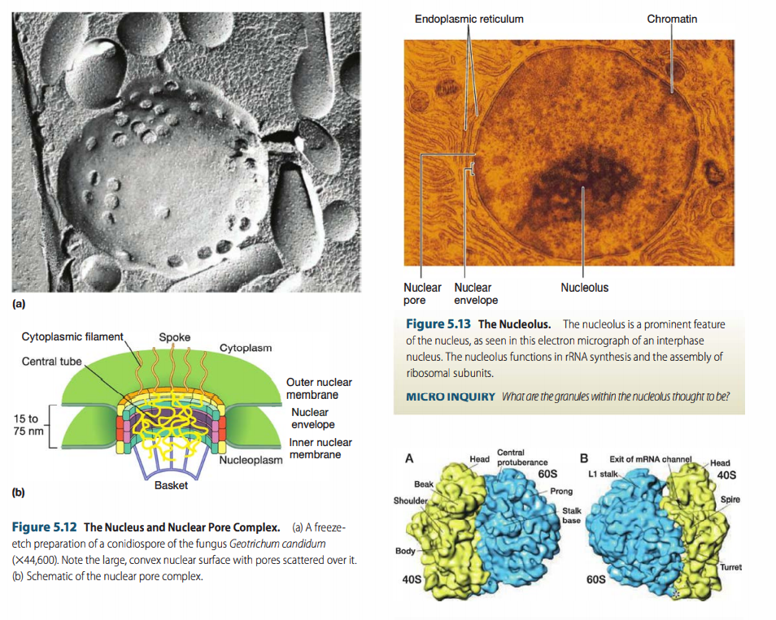

Slide 10
Chromosomes are very dynamic and vary in terms of their degree of compaction. When the cell is not dividing, there is less compaction. The highest degree of compaction occurs during cell division. Compaction is brought about in part by histones and other proteins, including condensins.
Condensins are also used by bacterial and archaeal cells to compact their chromosomes during cell division.
Tethering of one region of the chromosome to another and tethering of the chromosome to nuclear structures also contribute to chromosome folding and compaction.

Slide 11
Ribosomes
Eukaryotic ribosomes, i.e.,80S ribosomes (those not found in mitochondria and chloroplasts) are larger than bacterial and archaeal 70S ribosomes.
Each ribosome is a dimer of a 60S and a 40S subunit. The 60S subunit is composed of three rRNA molecules {5S, 28S, and 5.8S rRNAs) and about 50 proteins.
The 40S subunit is composed of an 18S rRNA and about 30 proteins. Each ribosome is about 22 nm in diameter and has a sedimentation coefficient of 80S and a molecular weight of 4 million.
Eukaryotic ribosomes are either associated with the ER or free in the cytoplasm. When bound to the ER to form rough ER, they are attached through their 60S subunits.
Both free and ER-bound ribosomes synthesize proteins. Proteins made on the ribosomes of the RER are often secreted or are inserted into the ER membrane as integral membrane proteins. Free ribosomes are the sites of synthesis for nonsecretory and nonmembrane proteins. Some proteins synthesized by free ribosomes are inserted into organelles such as the nucleus, mitochondrion, and chloroplast.

Slide 12
Cytoplasmic Organelles
Cell biologists have identified many types of organelles in the cytoplasm of eukaryotic cells. Among them are the ribosomes, endoplasmic reticulum, Golgi complex, lysosomes, peroxisomes, vacuoles, mitochondria, and chloroplasts.

Slide 13
Mitochondria
Mitochondria In aerobic eukaryotic cells, respiration occurs in the mitochondrion. When viewed with a transmission electron microscope, many mitochondria are cylindrical structures and measure approximately 0.3 to 1.0 flied by 5 to 10 11m. (In other words, they are about the same size as bacterial cells.)
The number of mitochondria per cell depends somewhat on the cell type and size. Some cells possess 1,000 or more mitochondria; others (some yeasts, unicellular algae, and trypanosome protists) have a single, giant, tubular mitochondrion twisted into a continuous network permeating the cytoplasm.
The mitochondrion is enclosed by a double membrane system. Like the nuclear membrane, the outermost mitochondrial membrane is relatively permeable and contains pores that allow the passage of small molecules.
The inner membrane is less permeable and its structure more closely resembles that of the cytoplasmic membrane of Bacteria.
Mitochondria also contain folded internal membranes called cristae. These membranes, formed by invagination of the inner membrane, contain the enzymes needed for respiration and ATP production, the major function of the mitochondrion. Cristae also contain transport proteins that regulate the passage of key molecules such as ATP into and out of the matrix, the innermost compartment of the mitochondrion. The matrix contains enzymes for the oxidation of organic compounds, in particular, enzymes of the citric acid cycle, the major pathway for the combustion of organic compounds to CO2.

Slide 14
The outer mitochondrial membrane separated from an inner mitochondrial membrane by a 6 to 8 nm intermembrane space. The outer mitochondrial membrane contains porins and thus is similar to the outer membrane of Gram-negative bacteria.
The inner membrane has infoldings called cristae (s., crista), which greatly increase its surface area. The shape of cristae differs in mitochondria from various species. P latelike (laminar) cristae, cristae shaped like disks, tubular cristae, and cristae in the shape of vesicles have all been observed.
The inner membrane encloses the mitochondrial matrix, a dense material containing ribosomes, DNA, and often large calcium phosphate granules.
In many organisms, mitochondrial DNA is a closed circle, like most bacterial DNA. However, in some protists, mitochondrial DNA is linear.
Each mitochondrial compartment has a characteristic chemical and enzymatic composition. For example, the outer and inner mitochondrial membranes possess different lipids.
Enzymes and electron carriers involved in electron transport and oxidative phosphorylation (the formation of ATP during respiration) are located only in the inner membrane. Enzymes of the tricarboxylic acid cycle and those involved with the catabolism (breaking down) of fatty acids are located in the matrix.

Slide 15
The mitochondrion uses its DNA and ribosomes to synthesize some of its own proteins. In fact, mutations in mitochondrial DNA often lead to serious diseases in humans. However, most mitochondrial proteins are manufactured under the direction of the nucleus and must be transported into the mitochondrion. Mitochondria reproduce by binary fission, a reproductive process used by many bacteria.

Slide 16
Hydrogenosomes
Some eukaryotic microorganisms are killed by O2 and, like many prokaryotes, live an anaerobic lifestyle. Such cells lack mitochondria and some of them contain structures called hydrogenosomes. Although similar in size to mitochondria, hydrogenosomes lack citric acid cycle enzymes and also lack cristae.
Microbial eukaryotes that contain hydrogenosomes carry out a strictly fermentative metabolism. Examples include the human parasite Trichomonas and various protists that inhabit the rumen of ruminant animals or anoxic muds and lake sediments.
The major biochemical reaction in the hydrogenosome is the oxidation of the compound pyruvate to H2, CO2, and acetate.
Some anaerobic eukaryotes have H2-consuming methanogens in their cytoplasm. These Archaea consume the H2 and CO2 produced by the hydrogenosome and use it to form methane (CH4). Because hydrogenosomes cannot respire, they cannot oxidize the acetate produced from pyruvate oxidation as mitochondria do. Acetate is therefore excreted from the hydrogenosome into the cytoplasm of the host cell

Slide 17
Chloroplasts
Plastids are cytoplasmic organelles of photosynthetic protists and plants. They often possess pigments such as chlorophylls and carotenoids, and are the sites of synthesis and storage of food reserves.
The most important type of plastid is the chloroplast. Chloroplasts contain chlorophyll and use light energy to convert C02 and water to carbohydrates and 02; that is, they are the site of photosynthesis.
Two major types of chloroplasts have been identified: those that evolved from a primary endosymbiotic event and those that evolved from a secondary (or tertiary) event. The chloroplasts of plants and some photosynthetic protists are primary plastids and are the focus of this discussion.
Chloroplasts are quite variable in size and shape, but they share many structural features. Most are oval with dimensions of 2 to 4 µm by 5 to 10 µm, but some photosynthetic protists possess one huge chloroplast that fills much of the cell. Like mitochondria, chloroplasts are encompassed by two membranes. A matrix called the stroma is enclosed by the inner membrane. The stroma contains DNA, ribosomes, lipid droplets, starch granules, and a complex internal membrane system whose most prominent components are flattened, membrane delimited sacs called thylakoids.

Slide 18
Organelles and Endosymbiosis
On the basis of their relative autonomy, size, and morphological resemblance to bacteria, it was hypothesized over 100 years ago that mitochondria and chloroplasts were descendants of respiratory and photosynthetic bacterial cells, respectively.
By associating with nonphototrophic eukaryal hosts, the latter gained a new form of energy metabolism while the symbiotic bacterial cells received a stable and supportive growth environment inside the host.
Gradually, over time these originally free-living symbionts became an intimate part of the eukaryotic cell. This idea of symbiotic bacteria as the ancestors of the mitochondrion, hydrogenosome, and chloroplast is called the endosymbiotic hypothesis (“endo” means “inside”) of eukaryotic cell origin and is now well accepted in biology.
Several lines of evidence support the endosymbiotic hypothesis. These include in particular the fact that mitochondria, hydrogenosomes, and chloroplasts contain their own genomes and ribosomes. The genomes are arranged in a circular fashion as for bacterial chromosomes, and the sequence of genes that encode ribosomal RNA from organelles clearly points to their bacterial origin.
Thus, the eukaryotic cell is a genetic chimera containing genes from two domains of life: host cell (Eukarya) genes and endosymbiont (Bacteria) genes.

