Slide 1
EUKARYOTIC CELL (Part-2)
Sonali Saha, Microbiology

Slide 2
Endoplasmic Reticulum
The endoplasmic reticulum (ER) is an irregular network of branching and fusing membranous tubules, around 40 to 70 nm in diameter, and many flattened sacs called cisternae (s., cisterna).
The nature of the ER varies with the functional and physiological status of the cell. In cells synthesizing a great deal of protein to be secreted, a large part of the ER is studded on its outer surface with ribosomes and is called rough endoplasmic reticulum (RER).
Other cells, such as those producing large quantities of lipids, have ER that lacks ribosomes. This is smooth endoplasmic reticulum (SER). The endoplasmic reticulum has many important functions. Not only does it transport proteins, lipids, and other materials through the cell, it is also involved in the synthesis of many of the materials it transports.
Lipids and proteins are synthesized by ER-associated enzymes and ribosomes. Polypeptide chains synthesized on RER-bound ribosomes may be inserted either into the ER membrane or into its lumen for transport elsewhere. The ER is also a major site of cell membrane synthesis.

Slide 3
Golgi Apparatus
The Golgi apparatus is composed of flattened, saclike cisternae. A complex network of tubules and vesicles is located at the edges of the cisternae.
In many eukaryotes, the cisternae are stacked on each other, forming a structure called a dictyosome. There are usually around four to eight cisternae in a stack.
In many cells, multiple stacks are linked to form a Golgi ribbon. Most eukaryotic microbes have just a single stack of cisternae, and in some, the cisternae are not in stacks (e.g., the yeast Saccharomyces cerevisiae).
A stack of cisternae has two faces that are quite different from one another. The sacs on the cis or forming face are closest to the ER and often associated with it. The sacs on the trans or maturing face are farthest from the ER.
The two faces of the Golgi differ in thickness, enzyme content, and degree of vesicle formation. The Golgi apparatus packages materials and prepares them for secretion, the exact nature of its role varying with the organism.

Slide 4
For instance, the surface scales of some flagellated photosynthetic and radiolarian protists are constructed within the Golgi apparatus and then transported to the surface in vesicles.
The Golgi often participates in the development of cell membranes and the packaging of cell products. The growth of some fungal hyphae occurs when Golgi vesicles contribute their contents to the wall at the hyphal tip.
Proteins that are accurately assembled are transported from the RER to the cis face of the Golgi complex in small transport vesicles formed from the ER membrane. Transport vesicles fuse with one another to form clusters that move along microtubules (part of the cytoskeleton) to the Golgi complex.

Slide 5
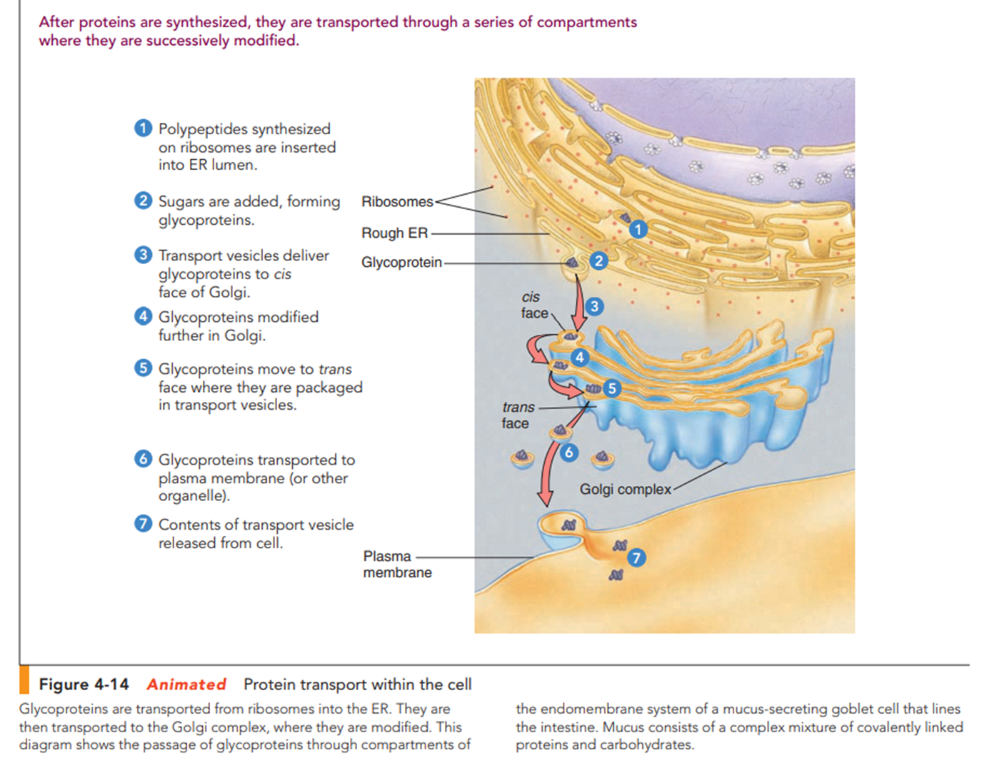

Slide 6
What happens to glycoprotein molecules released into the Golgi complex? One hypothesis holds that the glycoproteins are enclosed in new vesicles that shuttle them from one compartment to another within the Golgi complex. A competing hypothesis postulates that the cisternae themselves may move from cis to trans positions. Both hypotheses may prove true; glycoproteins may be transported by both methods.
Regardless of how proteins are moved through the Golgi complex, while there they are modified in different ways, resulting in the formation of complex biological molecules. For example, the carbohydrate part of a glycoprotein (first added to proteins in the RER) may be modified.
These vesicles pinch off from the Golgi membrane and transport their contents to a specific destination.
Vesicles transporting products for export from the cell fuse with the plasma membrane. The vesicle membrane becomes part of the plasma membrane, and the glycoproteins are secreted from the cell.

Slide 7
Other vesicles may store glycoproteins for secretion at a later time, and still others are routed to various organelles of the endomembrane system.
In some cases the carbohydrate component may be a “sorting signal,” a cellular zip code that tags the protein, routing it to a specific organelle. Glycoproteins are packaged in transport vesicles in the trans face.
In summary, here is a typical sequence followed by a glycoprotein destined for secretion from the cell:
Polypeptides synthesized on ribosomes protein assembled and carbohydrate component added in lumen of ER transport vesicles move glycoprotein to Golgi (cis face) glycoprotein further modified in Golgi in trans face, glycoproteins packaged in transport vesicles glycoproteins transported to plasma membrane contents released from cell.

Slide 8
Lysosomes
Lysosomes are small sacs of digestive enzymes (~40 different digestive enzymes) dispersed in the cytoplasm of most animal cells.
Because lysosomal enzymes are active under rather acidic conditions, the lysosome maintains a pH of about 5 in its interior. Lysosomal enzymes break down complex molecules in bacteria and debris ingested by scavenger cells.
The powerful enzymes and low pH that the lysosome maintains provide an excellent example of the importance of separating functions within the cell into different compartments.
Under most normal conditions, the lysosome membrane confines its enzymes and their actions. However, some forms of tissue damage are related to “leaky” lysosomes.

Slide 9
Primary lysosomes are formed by budding from the Golgi complex. Their hydrolytic enzymes are synthesized in the RER.
As these enzymes pass through the lumen of the ER, sugars attach to each molecule, identifying it as bound for a lysosome. This signal permits the Golgi complex to sort the enzyme to the lysosomes rather than to export it from the cell.
Bacteria (or debris) engulfed by scavenger cells are enclosed in a vesicle formed from part of the plasma membrane. One or more primary lysosomes fuse with the vesicle containing the ingested material, forming a larger vesicle called a secondary lysosome. Powerful enzymes in the secondary lysosome come in contact with the ingested molecules and degrade them into their components. Under some conditions, lysosomes break down organelles and allow their components to be recycled or used as an energy source.

Slide 10
In certain genetic diseases of humans, known as lysosomal storage diseases, one of the digestive enzymes normally present in lysosomes is absent. Its substrate (a substance the enzyme would normally break down) accumulates in the lysosomes, ultimately interfering with cell activities. An example is Tay–Sachs disease, in which a normal lipid cannot be broken down in brain cells. The lipid accumulates in the cells and causes mental retardation, blindness, and death before age 5.

Slide 11
Vacuoles
Many functions carried out in animal cells by lysosomes are performed in plant and fungal cells by a large, single, membrane-enclosed sac called a vacuole. The membrane of the vacuole, part of the endomembrane system, is called the tonoplast.
The term vacuole, which means “empty,” refers to the fact that these organelles have no internal structure. Vacuoles are usually larger structures, sometimes produced by the merging of many vesicles.
Vacuoles play a significant role in plant growth and development. Immature plant cells are generally small and contain numerous small vacuoles.
As water accumulates in these vacuoles, they tend to coalesce, forming a large central vacuole.
A plant cell increases in size mainly by adding water to this central vacuole. As much as 90% of the volume of a plant cell may be occupied by a large central vacuole containing water, as well as stored food, salts, pigments, and metabolic wastes. (The vacuole may serve as a storage compartment for inorganic compounds. In seeds, vacuoles store molecules such as proteins.

Slide 12
Because the vacuole contains a high concentration of solutes (dissolved materials), it takes in water and pushes outward on the cell wall. This hydrostatic pressure, called turgor pressure, provides much of the mechanical strength of plant cells.
The vacuole is important in maintaining homeostasis. E.g., it helps maintain appropriate pH by taking in excess hydrogen ions. Plants lack organ systems for disposing of toxic metabolic waste products. Plant vacuoles are like lysosomes in that they contain hydrolytic enzymes and break down wastes, as well as unneeded organelles and other cell components. Wastes may be recycled in the vacuole, or they may aggregate and form small crystals inside the vacuole.
Compounds that are noxious to herbivores may also be stored in some plant vacuoles as a means of defense. Vacuoles are also present in many types of animal cells and in unicellular protists such as protozoa. Most protozoa have food vacuoles, which fuse with lysosomes that digest the food. Some protozoa also have contractile vacuoles, which remove excess water from the cell.

Slide 13
Peroxisomes
Peroxisomes are membrane-enclosed organelles containing enzymes that catalyze an assortment of metabolic reactions in which hydrogen is transferred from various compounds to oxygen.
Peroxisomes get their name from the fact that during these oxidation reactions, they produce hydrogen peroxide (H2O2). Hydrogen peroxide detoxifies certain compounds; but if it were to escape from the peroxisome, it would damage other membranes in the cell.
Peroxisomes contain the enzyme catalase, which rapidly splits excess hydrogen peroxide to water and oxygen, rendering it harmless.
Peroxisomes are found in large numbers in cells that synthesize, store, or degrade lipids. One of their main functions is to break down fatty acid molecules.
Peroxisomes also synthesize certain phospholipids that are components of the insulating covering of nerve cells. In fact, certain neurological disorders occur when peroxisomes do not perform this function.

Slide 14
Mutations that cause abnormal peroxisome-membrane synthesis are linked to some forms of mental retardation.
When yeast cells are grown in an alcohol-rich medium, they manufacture large peroxisomes containing an enzyme that degrades the alcohol.
Peroxisomes in human liver and kidney cells detoxify certain toxic compounds, including ethanol, the alcohol in alcoholic beverages.
In plant seeds, specialized peroxisomes, called glyoxysomes, contain enzymes that convert stored fats to sugars. The sugars are used by the young plant as an energy source and as a component

Slide 15
